Slide 1

Credit Card Fraud Detection
INFO 6105: Data Science Engineering Methods
Team 5 · Hiteshi Kawadia | Preksha Praveen
Kaggle ULB Dataset · 284,807 Transactions
Notes:
1

Slide 2
What is credit card fraud?
1
2
3
4
Scale of the Problem
Account Takeover Fraud
New Account Fraud
Why it Keeps Growing
Billions of dollars are lost globally every year to credit card fraud, affecting consumers, merchants and financial institutions.
A thief steals existing card credentials and makes unauthorized purchases on the victim's account.
A thief uses stolen identity information to open a brand new credit card account in someone else's name.
Digital payments, stolen credentials and automated attacks make fraud easier to scale than ever before.
Notes:
2

Slide 3




Why Current ML Models Fail at Fraud Detection
Rigid rule-based systems
Class imbalance
Wrong optimization objective
Signals buried in noise
Fraud cases are rare, so models can look accurate while still missing attacks.
They miss evolving fraud patterns and adapt too slowly.
Fraud indicators are subtle and often hidden among legitimate transactions.
Accuracy alone is not enough when false negatives are costly.
Notes:
3

Slide 4
DATASET: ULB Credit Card Fraud Dataset
284,807
492
TRANSACTIONS
FRAUD CASES
in total for the dataset
0.172% of total
31
150MB
FEATURES
FILE SIZE
V1–V28, Time, Amount, Class
Exceeds 100MB requirement
FEATURE BREAKDOWN
DATA QUALITY
V1–V28: PCA-transformed for confidentiality
Amount: transaction value in Euros
Time: converted to Hour-of-Day (0–23)
Class: 1 = Fraud, 0 = Legitimate
Zero missing values across all 31 columns
1,081 duplicate rows removed during cleaning
All features numeric — no encoding needed
Amount skew = 17.29 before scaling
Notes:
4

Slide 5
EXPLORATORY DATA ANALYSIS
Key findings from EDA:
AMOUNT PATTERN
TIME PATTERN
Fraud median = $9.25 vs. legitimate = $22.00.
Fraud peaks at hours 2 and 11 i.e late night and mid-morning when monitoring may be lower.
Fraudsters keep amounts small to avoid detection.
FEATURE CORRELATION
V14 (−0.30) and V17 (−0.33) most negatively correlated with fraud. Later confirmed by Random Forest importance.
CLASS: 99.83% legitimate vs. 0.17% fraud IMBALANCE CONFIRMED which is a 578:1 ratio which confirmed that SMOTE(Synthetic Minority Oversampling Technique) was essential and accuracy would be misleading throughout.
Notes:
5

Slide 6
PREPROCESSING PIPELINE
Clean
Remove 1,081 duplicates. Derive Hour from Time, then drop raw Time.
Duplicates bias the model by overrepresenting certain transactions.
Split first
80/20 stratified split before any scaling or resampling.
Splitting before scaling prevents data leakage. Test statistics must never influence training transformations.
Scale
StandardScaler on Amount and Hour only. fit_transform on train, transform on test.
V1–V28 already PCA-scaled. After scaling: mean ≈ 0, std ≈ 1 confirmed for both features.
SMOTE
Applied to training set only. Balances 578:1 → 1:1 (226,602 each class).
Generates synthetic fraud samples by interpolating between real cases. Test set left unchanged to reflect real-world conditions.
Each step has a strict order: split before scaling prevents data leakage; SMOTE applied to training set only and test set left unchanged to reflect real-world conditions.
Notes:
6

Slide 7




MODEL BUILDING
Four supervised classifiers
LOGISTIC REGRESSION
DECISION TREE
Linear interpretable baseline. GridSearchCV tunes C ∈ [0.01–100] over 5-fold StratifiedKFold. class_weight='balanced' for extra imbalance protection.
Most interpretable model where tree structure shows exactly which features drive each fraud prediction. Does not require feature scaling. Root split confirmed on V14.
RANDOM FOREST
K-NEAREST NEIGHBORS
Ensemble of 50 trees. Reduces overfitting vs. single tree. Feature importance confirms V14 as dominant predictor which consistent with EDA correlation findings.
Classifies by k=5 nearest neighbors. Motivated by fraud clustering intuition from k-Means. Requires feature scaling. Trained on pre-SMOTE data for computational efficiency.
Metrics: Precision · Recall · F1-Score · ROC-AUC. Accuracy excluded due to class imbalance
Notes:
7

Slide 8
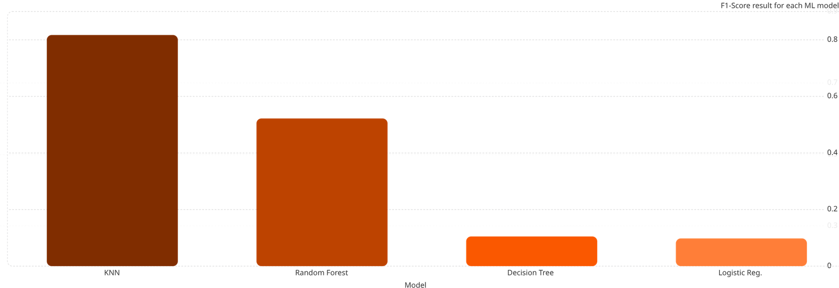
RESULTS
0.82
0.52
0.11
0.1
MODEL
PRECISION
RECALL
F1-SCORE
ROC-AUC
BEST AT
KNN
0.9710
0.7053
0.8171
0.8999
F1 + Precision
Random Forest
0.4149
0.8211
0.5512
0.9812
ROC-AUC
Logistic Reg.
0.0520
0.8737
0.0981
0.9628
Recall
Decision Tree
0.0415
0.8421
0.0792
0.9007
Interpretability
Notes:
8

Slide 9
RECOMMENDATION
KNN : Recommended Model
High-Value Fraud Risk
Operational Efficiency
Highest F1-Score (0.8171) — best balance of precision and recall
Precision of 0.9710 — 97% of fraud alerts are genuine fraud cases
Only 3 false positives in 56,746 test transactions
Fraud investigation teams can trust nearly every flagged alert
Use Random Forest since it has highest ROC-AUC and adjust threshold for recall.
Use KNN with best F1, minimal false alarms.
Regulatory Explainability
Use Decision Tree alongside KNN.
Notes:
9

Slide 10
CONCLUSION
Key takeaways
Metric Selection Matters
Pipeline Order Matters
No Universally Best Model
In imbalanced problems, the metric you optimize for is as important as the model you choose.
Split before scaling. Scale before SMOTE. SMOTE on training only. Every step has a data leakage implication.
KNN wins on F1, RF wins on ROC-AUC, LR wins on Recall. The right choice depends on deployment and business context.
Notes:
10

